Slide 1
Air Quality Public Meeting
USS ET Hot Strip Mill
Braddock, PA
Allegheny County Health Department - Air Quality Program
Carnegie One Library - Braddock
October 15, 2026

Slide 2
Notice
This presentation is intended for educational and informational purposes only and does not constitute professional (or legal) advice. The views and opinions expressed in this presentation are those of the presenter and do not reflect the official policy or position of the Allegheny County Health Department.

Slide 3
Agenda
Introduction
Ground Rules
ACHD Air Quality Overview
Proposed Project at US Steel Edgar Thomson
Air Permits
How Can You Get Involved?
Q & A

Slide 4
Ground Rules
Please turn off cellphones. Take any calls outside of the room.
Signs or posters are not permitted inside the room.
This meeting is meant to ANSWER QUESTIONS from residents about the USS Hot Strip Mill permit or permitting process
Questions will be addressed during the Q&A portion of tonight’s agenda.
The library closes at 7:00pm – we must be respectful of the library employees’ time and be out by 7:00pm.

Slide 5
Ground Rules (cont.)
There will be a 2 minute time limit per speaker's questions in order to ensure we're giving everyone an opportunity to speak. You may choose to get back in line if your time is up.
All questions/comments shall be directed at the facilitator
Respectful communication shall happen across the room
Refusal to follow ground rules, being disruptive, disrespectful or in any way a threat to the meeting decorum or participant safety will be cause for removal from the library.

Slide 6
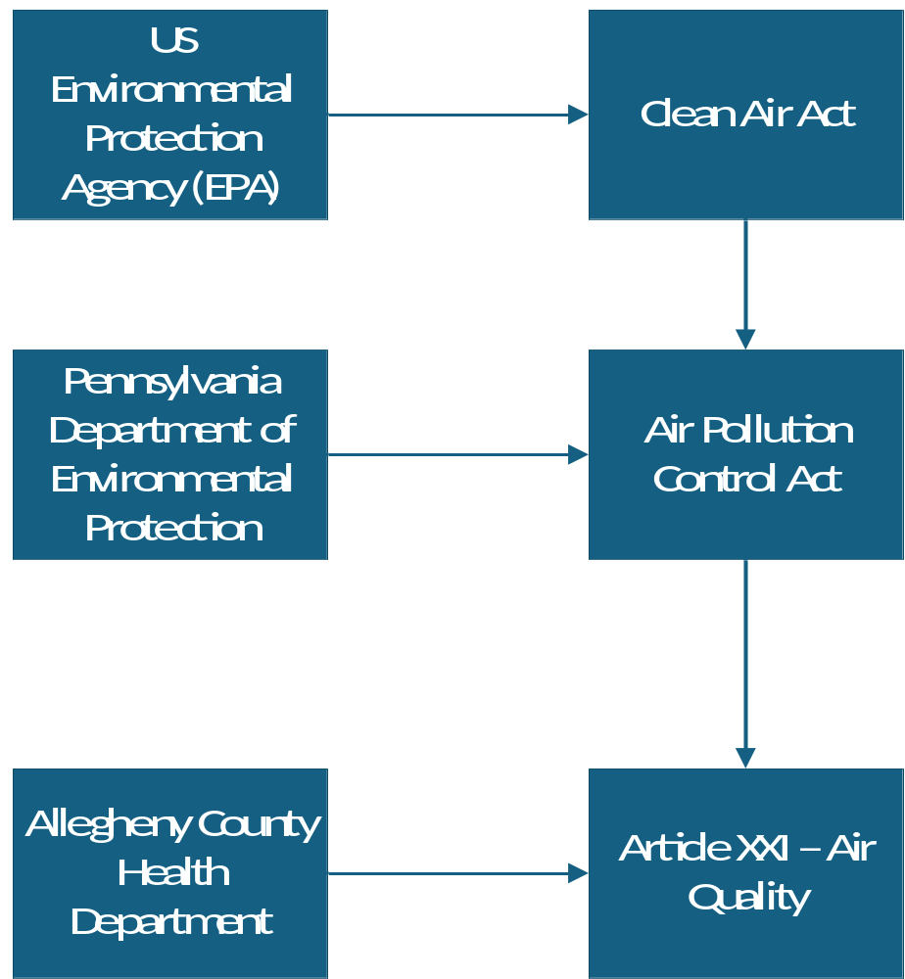
Who Regulates Air Pollution?

Slide 7
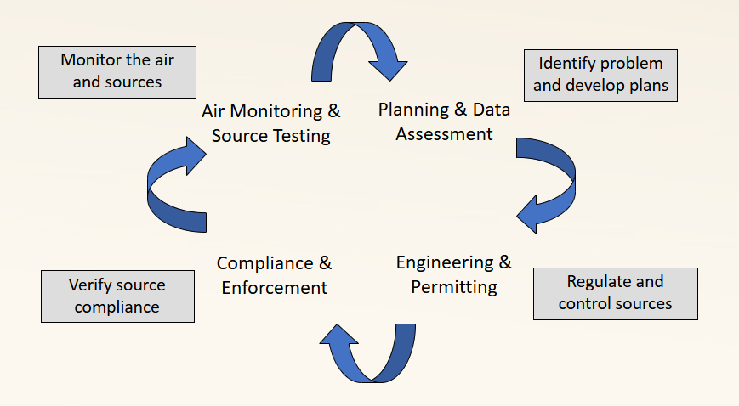
Air Quality Program

Slide 8
Air Quality Program - Permitting
What Air Quality regulations do facilities have to meet, and how will they show they are meeting them?
~400 permitted facilities
28 Title V sources
Major, minor, small minor, and synthetic minor sources
Types of Air Permits:
  Request for Determination
    Does this facility need a permit?
  Installation Permits
    Also known as construction permits or plan approvals
  Minor, Small Minor, and Synthetic Minor Operating Permits
  Title V Operating Permits

Slide 9
Air Quality Program - Planning
Develop State Implementation Plans (SIPs)
Update and revise air quality regulations (Article XXI)
Monitored data assessment
Air quality dispersion and chemical modeling
Emissions inventories reviews and submittals
Air quality forecasting & meteorological studies
EPA grant applications
Source tracking

Slide 10
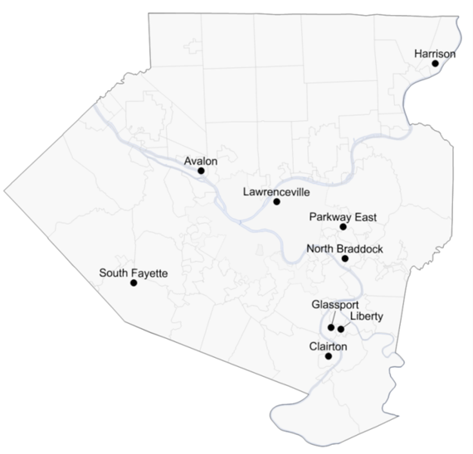
Air Quality Program - Monitoring
Perform air measurements to produce defensible environmental data of known quality such that regulatory decisions can be made:
  National Ambient Air Quality Standards (NAAQS)
  Demonstrate compliance with local, state, and federal regulations
  Surface meteorology stations
  Air toxics and special studies
  Maintain record of current and historical air quality

Slide 11
Air Quality Program - Enforcement
Responsible for ensuring compliance with federal, state, and county regulations
  What does this mean?
    Inspection Program - Onsite visits, Reviewing documents
    Response to complaints
    Compliance assistance
    Issue enforcement actions in response to identified compliance issues
  What is the scope of work?
    BROAD! From Gas stations to bridge painting to large industrial facilities, Enforcement inspects them all
    Asbestos – commercial renovation and demolition, abrasive blasting, large and small permitted facilities, metal shops and welding, paint booths, aggregate piles, construction dust, diesel idling

Slide 12
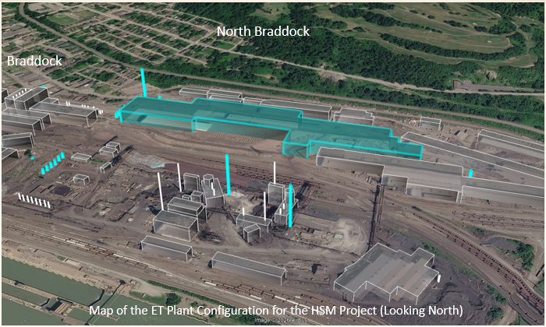
Project Overview – Plant Configuration
North Braddock
Braddock
Map of the ET Plant Configuration for the HSM Project (Looking North)

Slide 13
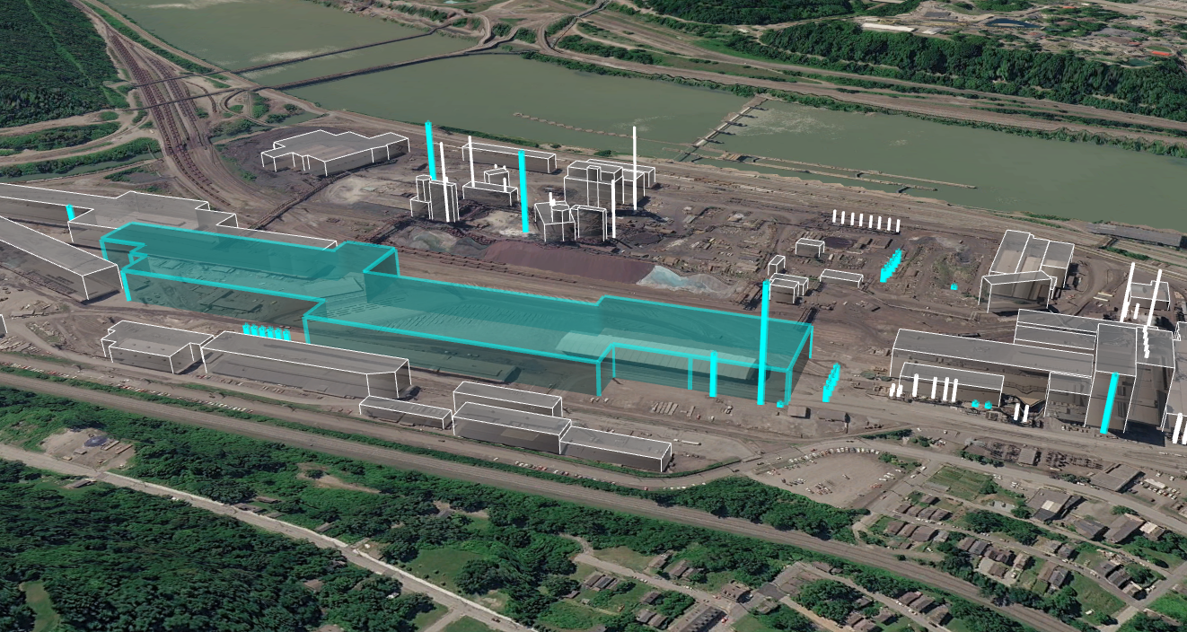
Project Overview – Plant Configuration (cont.)
Duquesne
West Mifflin
North Braddock
Braddock
Map of the ET Plant Configuration for the HSM Project (Looking South)

Slide 14

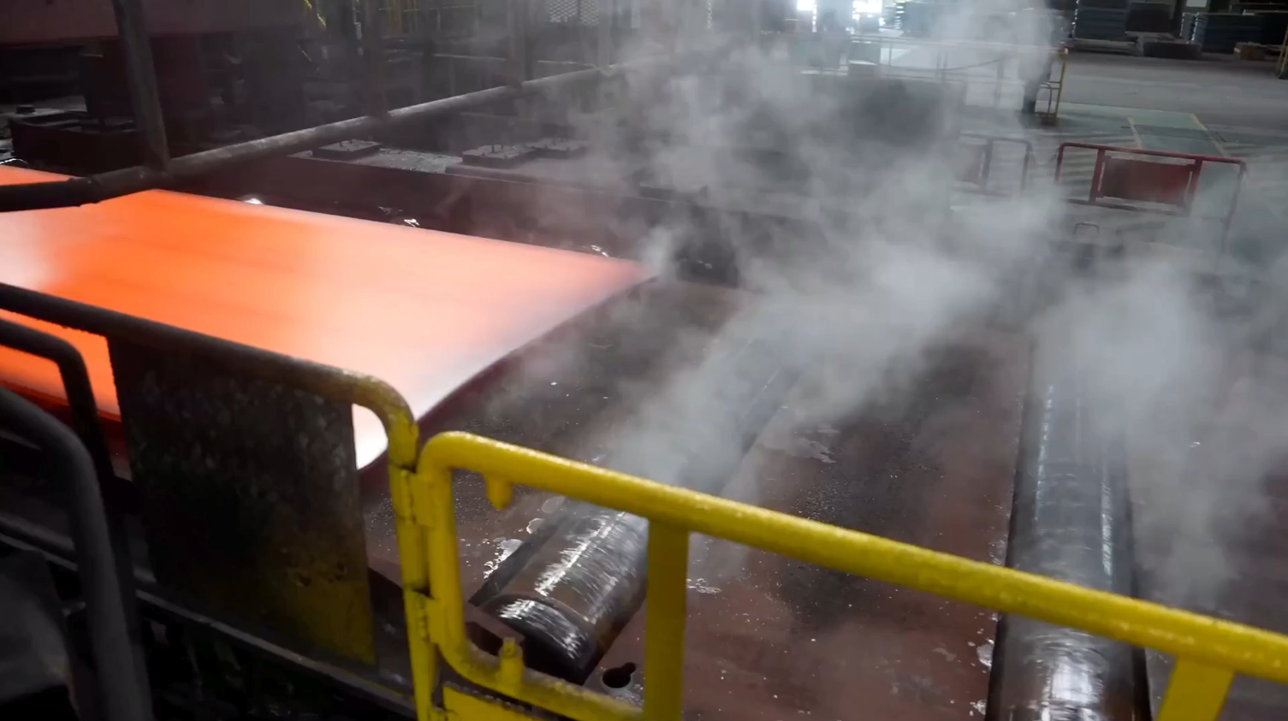
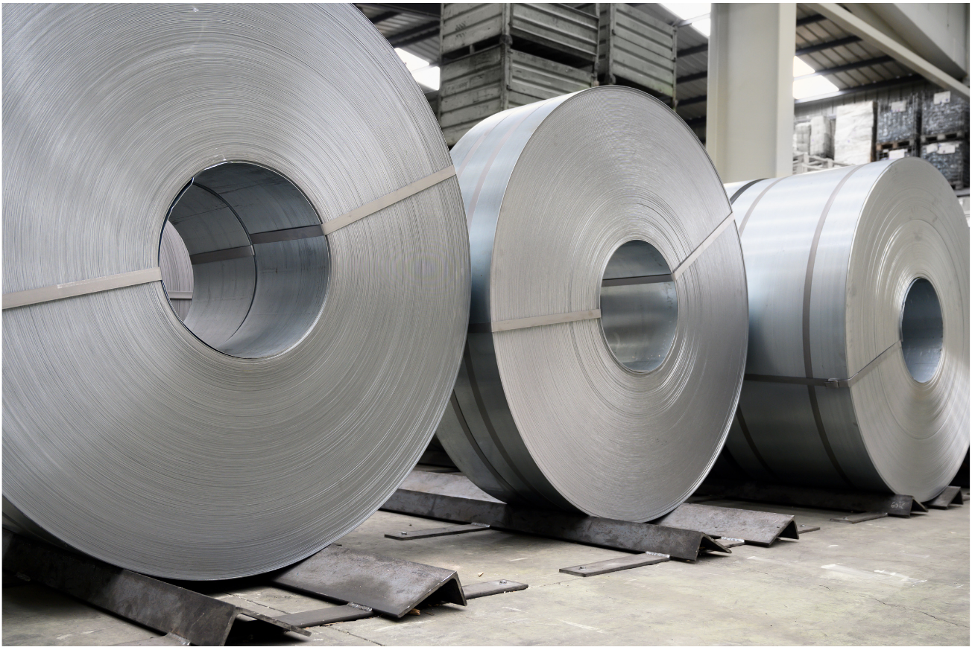
Project Overview – Hot Strip Mill
Steel slab is reheated and cleansed of impurities
Slab is rolled into longer, thinner piece of steel
Steel is coiled into a large roll and cooled

Slide 15
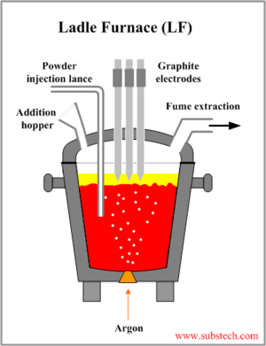
Project Overview – Ladle Metallurgy Furnace
The ladle metallurgy furnace supports the heating of the molten steel in the ladle
Chemical processes, like removing gasses and adding alloys, are performed to change the properties of the molten steel
Refined molten steel then moves to the existing slab caster

Slide 16
Project Overview
U.S. Steel – Edgar Thomson Works
  What is the installation permit application for?
    A new Hot Strip Mill, including two (2) new natural gas / coke oven gas fired walking beam reheat furnaces
    A new additional Ladle Metallurgy Facility
    A new slab grinder to size slabs for the new Hot Strip Mill
    Auxilliary cooling towers and emergency diesel engines (for power and fire protection)
  What is a Hot Strip Mill?
    A hot strip mill takes slabs of steel and rolls them into long, flat strips of coiled sheet metal.
  What is a Ladle Metallurgical Facility?
    In the ladle metallurgical facility, molten steel from the Basic Oxygen Furnace is refined impurities are removed before the steel is casted into slabs.

Slide 17
Project Overview (cont.)
U.S. Steel – Edgar Thomson Works
  What will happen to the U.S. Steel - Irvin Works?
    The hot strip mill at Irvin will be shut down
    Irvin will continue finishing steel products
  Will this affect the operating permit for U.S. Steel – Edgar Thomson Works?
    New sources from installation will be incorporated into operating permit revisions
    Existing sources are mostly unchanged
  How will this affect emissions?
    Modeling shows an increase in emissions once the hot strip mill is functional, but the County would still be within the federal limits for the National Ambient Air Quality Standards (NAAQS)
    Most new operations will be emitted to tall stacks

Slide 18
What are the Emissions?
PM (particulate matter) – small particles of mostly carbon that are a product of combustion
VOC (volatile organic compounds) – carbon-containing chemicals that easily evaporate into the air at room temperature
NO_{X} (nitrogen oxides) – formed under high heat when oxygen reacts with nitrogen in the air. Combines with VOC to make ozone (smog)
SO_{X} (sulfur oxides) – formed when sulfur in the fuel reacts with oxygen
CO (carbon monoxide) – formed when carbon in the fuel does not completely react with oxygen.
CO₂ (carbon dioxide) – a by-product of combustion

Slide 19
Potential Emission Changes
Pollutant | Current USS ET Facility-Wide PTE (tpy) | Proposed Increase at USS ET (tpy) | Proposed Decrease at USS Irvin (tpy)
PM | 1,525.71 | +43.28 | -91.25
PM₁₀ | 1,434.76 | +30.54 | -91.25
PM_{2.5} | 1,367.84 | +25.96 | -91.25
NO_{X} | 1,356.54 | +146.58 | -417.50
SO₂ | 3,858.04 | +247.76 | -475.80
CO | 19,157.94 | +61.96 | -285.05
VOC | 166.69 | +15.11 | -6.65

Slide 20
Permitting Process
Application Receipt and Review
  Regulatory analysis
  Calculation of emissions
  Permit & TSD draft and internal review
Public Comment Period
  Open now!
Response to Comments
Issuance

Slide 21
What’s in an Air Permit?
Restrictions
  Regulations, limits, and standards the facility must meet
Testing, Monitoring, Recordkeeping, Reporting
  How the facility will demonstrate compliance with the restrictions
Work Practice Standards
  Any additional requirements to reduce air emissions

Slide 22
Opportunities for Involvement
You can ask questions at this meeting
  Air Quality will provide a verbal answer to questions
  Note: no oral testimony will be taken at this meeting
Give oral testimony at the public hearing scheduled for Tuesday, November 10 (5:00pm – 7:00pm, Carnegie One Public Library)
  To speak at the public hearing, you must register using ACHD’s Public Hearing Participation form at least 24 hours before the hearing
Submit written comments (mail or email)
  The public comment period is open now and closes at 11:59 pm on November 17
  Mail written comments to:
  ACHD Air Quality Program
  836 Fulton Street
  Pittsburgh, PA 15233
  Email AQPermits@AlleghenyCounty.us with your comment

Slide 23
Writing an Effective Public Comment
The most impactful comments are original, fact-based, short, relevant to the permit at hand, and include a list of sources
Please include the name of the facility and the type of permit
Clearly identify the section(s) of the permit your comment is addressing
Lay out your argument(s) and evidence
  Provide specific, relevant arguments
  Support your argument with data and analyses
  Include references
Describe your suggestions and specific changes
Contact Air Quality if you have questions

Slide 24
Opportunities to Review Application Materials
This application and draft permit are composed of hundreds of pages of materials
If you encounter any issues accessing the application materials, please email AQPermits@AlleghenyCounty.us
Virtual copies can be found at the following locations:
  ACHD Regulated Entities Portal (Public)
  Public Comment Notices - Allegheny County, PA

Slide 25
Contact Information
AQPermits@AlleghenyCounty.us

Slide 26
Q & A
Keep your questions focused on the topic at hand and please only ask one question during your time at the podium. If you would like to ask another question, you may get back in line.
Be constructive and respectful and engage in dialogue rather than debate. Please allow space for all parties and participants.
Comments made are not considered received comments on the permit draft. You will still need to formally submit your comments on the permit.

Slide 27
15 Minute Warning
If you have other questions please email:
  AQPermits@AlleghenyCounty.US
  We will respond and answer your questions!

